Slide 1
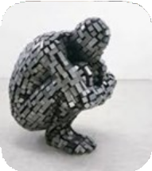
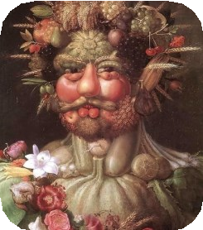
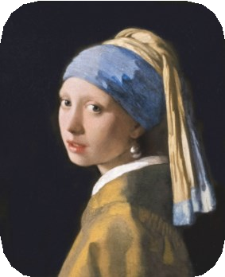
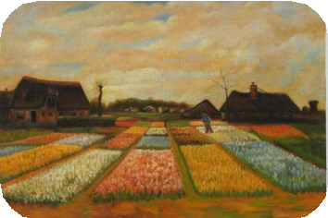
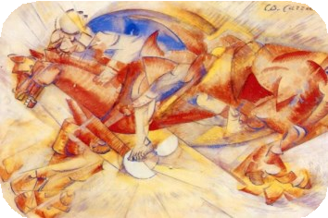
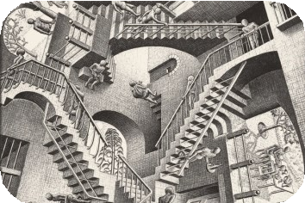
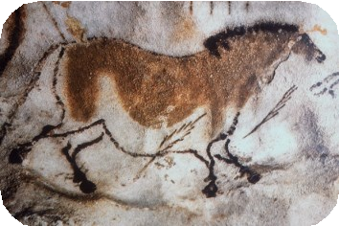
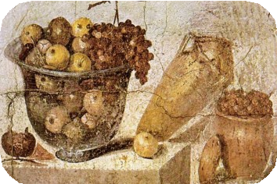
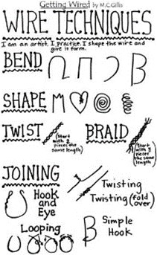
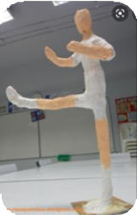
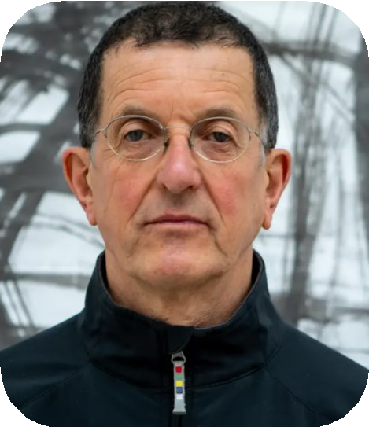
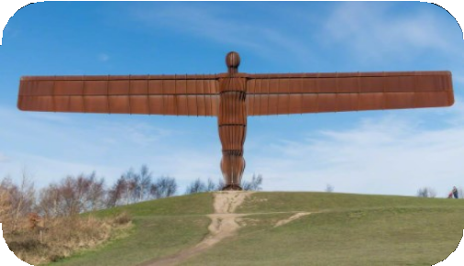
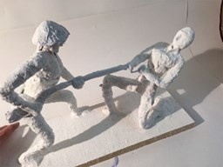
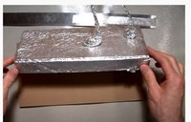
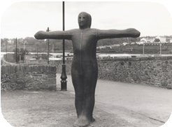
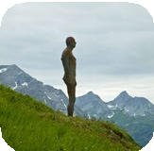
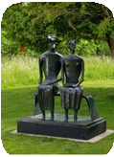
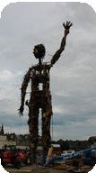
Year 6- Summer Art - How can we learn to combine a range of materials to create an effective abstract sculpture of a figure?
Historical and cultural development of art
Cave Paintings
Arcimboldo (1591) Vertumnus
Vermeer (1665) Girl with a Pearl Earring
Vincent van Gogh (1883) Bulb Fields
Carlo Carra (1913) The Red Horseman
M.C. Escher (1953) Relativity Lattice
(30,000 BC)
Citrus Fruit (63-79 BC)
Glossary:
Mod Roc- This looks like a bandage and starts off dry. To start modelling with it, you dip it in water and it becomes hard when dry.
Papier-mâché- This is a mixture of paper and glue,
that becomes hard when dry.
Sculpture- This is a 3 dimensional piece of art work, that can make by shaping, carving, building or
moulding.
Figurative sculpture- This is a sculpture that is made to look like the person who it is meant to be.
Proportion- Making sure the sizes are accurate so
that the figure looks realistic.
Anthony Gormley (1950 -
Present Day)
He was born in 1950
He is mainly known for his sculptures of human forms.
His most famous sculpture is the ‘Angel of the North’.
Pupil will sculpt a person in movement
Sticky Knowledge:
Know how to combine different materials
to create a sculpture.
Know and be able to explain Andy Gormley’s style.
Know and describe sculptural forms in landscapes.
Explain how art has changed over time.
Know how to plan and design an abstract sculpture.
Papier-Mache | Sculpture base
Sculptures of human form

