Slide 1
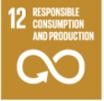
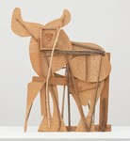
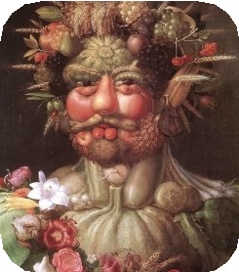
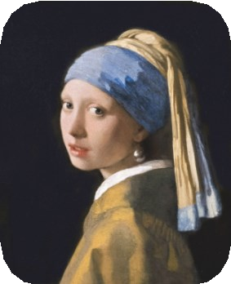
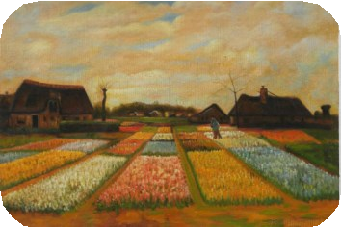
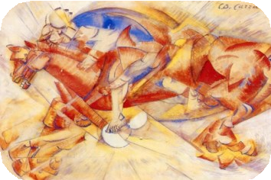
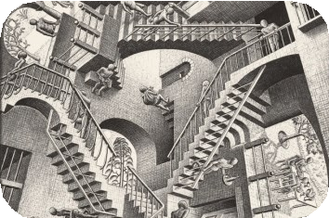
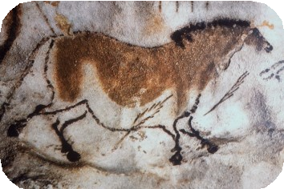
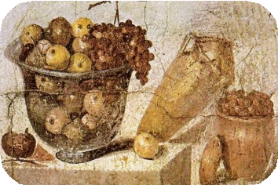
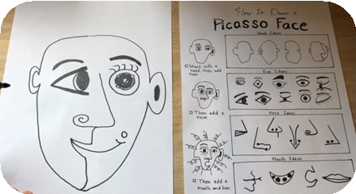
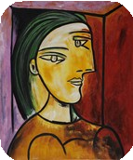
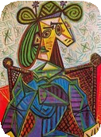
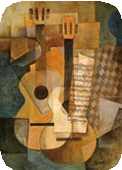
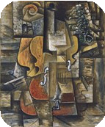
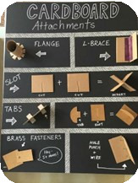
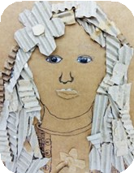
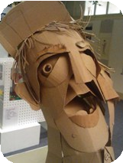
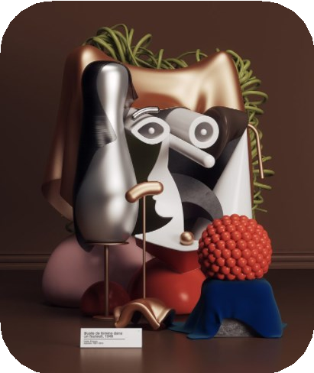
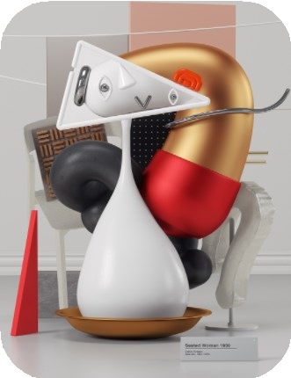
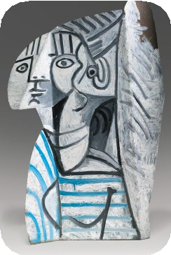
Year 5 - Summer Art - How can we learn to combine a range of materials to create an effective Cubism sculpture of a head?
Historical and cultural development of art
Cave Paintings
Arcimboldo (1591) Vertumnus
Vermeer (1665) Girl with a Pearl Earring
Vincent van Gogh (1883) Bulb Fields
Carlo Carra (1913) The Red Horseman
M.C. Escher (1953) Relativity Lattice
(30,000 BC)
Citrus Fruit (63-79 BC)
Sculpture
Explore f aces in Picasso’s Style
Adding detail/texture using a range of materials
Pupils will create a 3D face in the cubism style.
Glossary:
Cubism- This is a style of art which aim to show all of the possible
viewpoints of a person or object all at once. It is called cubism
because the items represented in the artwork look like they are made out of cubes.
Abstract- Art that does not attempt to represent an image accurately but instead uses shapes, colours and forms to create a
composition.
Sculpture-This is a piece of art that
has been made 3 dimensional. Materials could be carved, modelled, moulded, sewn, assembled etc.
Papier-mâché- Paper and glue are used over a structure, to make it go hard.
Free-standing- The sculpture will stand up by itself and does not need anything else to support it.
Sticky
Knowledge:
Explain how
impressionism
has moved to cubism.
Know how to combine
different materials to create a
sculpture.
Know what a
cubism sculpture is.
Know and be able to explain
Omar Aqil’s style.
Know how to
plan and
design a sculpture.
Pablo Picasso (1881-1973) Cubism
Pablo Picasso was one of the greatest artists of the 20th cen- tury, famous for paintings like 'Guernica' and for the art movement known as Cubism.
Omar Aquil (Present Day Artist) 3D Cubism

