Slide 1
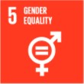
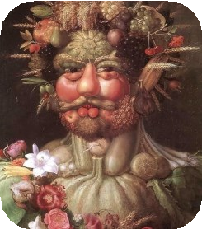
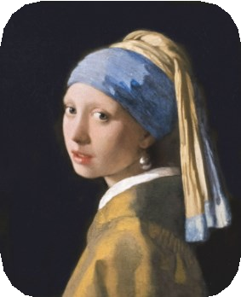
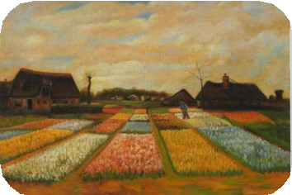
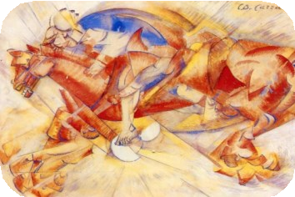
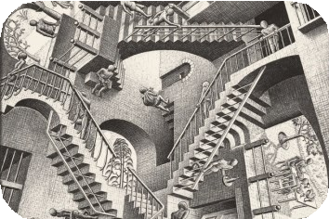
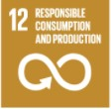
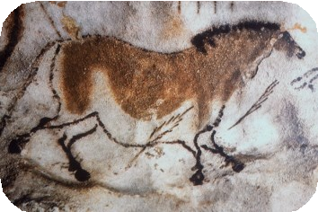
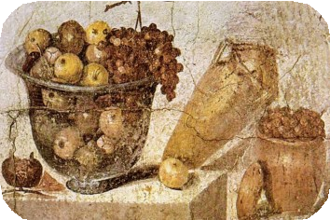
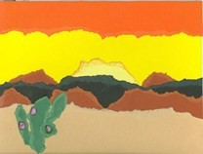
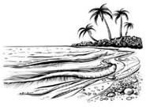
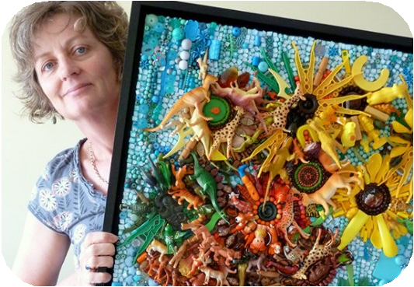
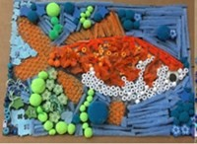
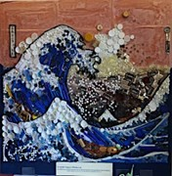
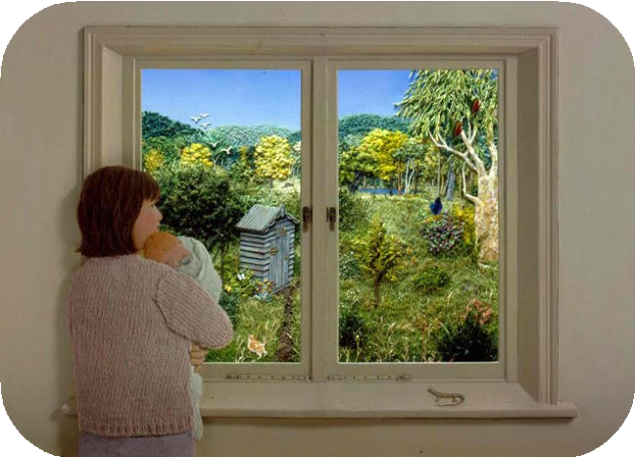
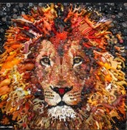
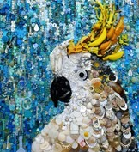
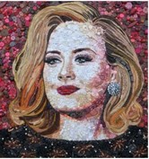
Year 4 - Summer Art - How can we learn to combine recycled materials and objects to create effective pieces of art?
Historical and cultural development of art
Cave Paintings
Arcimboldo (1591) Vermeer (1665) Vertumnus Girl with a Pearl Earring
Vincent van Gogh (1883) Bulb Fields
Carlo Carra (1913) The Red Horseman
M.C. Escher (1953) Relativity Lattice
(30,000 BC)
Citrus Fruit (63-79 BC)
Explore Collage | Study Landscape
Collage using objects | Pupils will create a collage of a landscape in the style of Jane Perkins.
Glossary:
Collage-A piece of art made by sticking various different materials into an arrangement, that create a picture.
Bric-a-brac- These are small objects such as toys or
ornaments that are no longer wanted.
Recycled materials-These are materials that can be used again for another purpose eg- paper, card board, bottle tops, magazines
Tone- One colour can have lots of different tones to it. It can
range from the light to dark.
Shade-This is where the shadow would be formed so darker tones of the colour would be used.
Landscape- This is an area of land that can be seen.
Jane Perkins— Present day Artist
Jane Perkins loves and creates artwork with an element of fun and the unexpected. Each
collages is made from thousands of pieces of salvaged bric-a-brac
which are carefully glued
into place to make the picture. Random small objects are used, such as plastic toys, shells, beads, buttons etc.
Sticky Knowledge:
Name an artist who uses a collage
style.
Know that images made from collage are a form of art.
Know what it means to interpret an image through collage.
Know how to use collage to make a smooth, rough, plain or pattern surface.
“This may sound obvious but I have always been inspired by Picasso who tried so many different media,” explained Jane.
‘The Window’ by Jennie Baker

