Slide 1
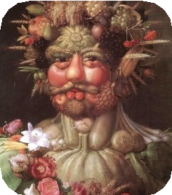
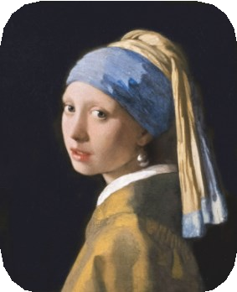
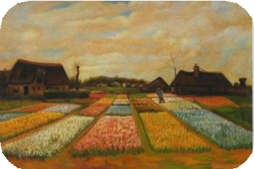
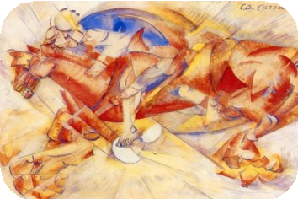
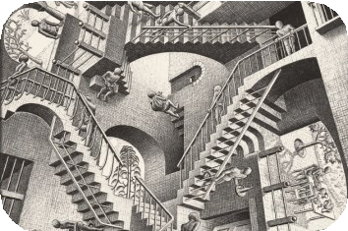
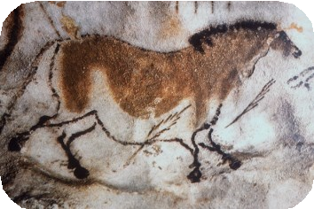
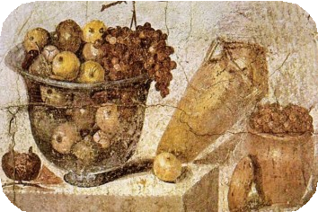
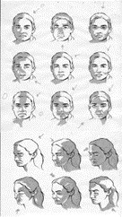
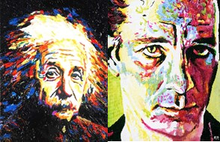
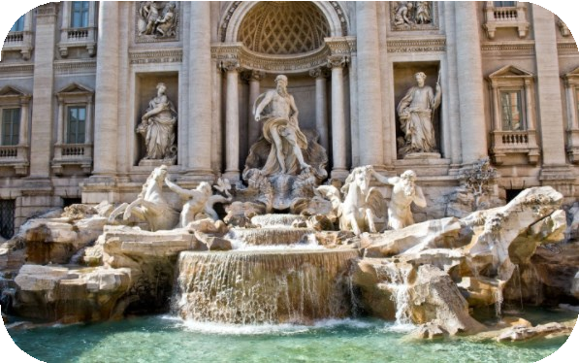
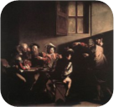
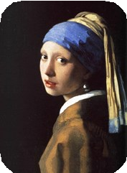
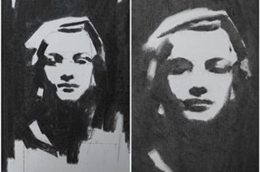
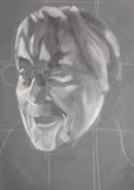
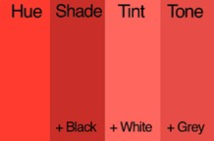
Year 3 - Summer Art - How can we learn to use the techniques of different artists to create an effective painting of a face?
Historical and cultural development of art
Cave Paintings
Arcimboldo (1591) Vermeer (1665) Vertumnus Girl with a Pearl Earring
Pupils will paint a portrait-
Vincent van Gogh (1883) Bulb Fields
Carlo Carra (1913) The Red Horseman
M.C. Escher (1953) Relativity Lattice
half in the Baroque style (showing mood, tension and tones) and half in a modern style (showing light and using textures with paint).
(30,000 BC)
Citrus Fruit (63-79 BC)
Baroque art (1600’s)
Glossary:
Portrait- This is a drawing or a painting of someone’s head and shoulders.
Emotion- This is how the
painting makes us feel.
It began in Italy, then moved around Europe and across the world. The Catholic church wanted paintings that were religious, but also were emotional and dramatic, filled with life and move- ment, rather than being still and flat.
How to create texture using acrylic paint
Baroque art was full of action and movement - flying angels, people fighting or crowds cower- ing in fear. Everything was made to be engaging, emotional and very dramatic - exciting scenes playing out in front of the viewer, like in a theatre.
Some famous Baroque artists include Caravaggio, Rembrandt and Andrea Pozzo.
Trevi Fountain—Rome
Mood –This is the atmosphere the painting shows.
Tones- In painting, tone refers to how light or dark a colour is.
Blend– This is the technique where 2 or more colours are mixed together to create a
gradual transition of the colours.
Brush stroke-This is a mark made by a paintbrush across a surface.
Texture- This refers to the look and feel of how the paint has been painted onto the surface.
Dramatic modern paintwork
Sticky Knowledge:
Know when the Baroque period occurred.
Looking at light and dark tones
Name a Baroque/modern artist.
Know that Baroque art portrays tension and emotion.
Know how to paint light, dark using tints and tones.
Know which brush to choose for a given mark.
Know how to start a painting from a drawing.

