Slide 1
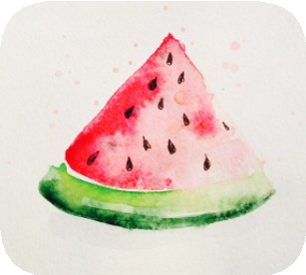
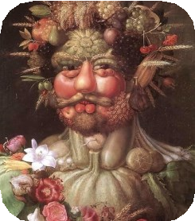
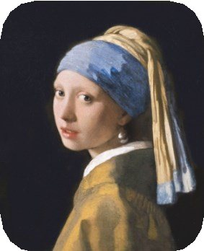
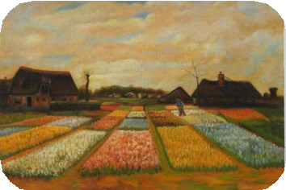
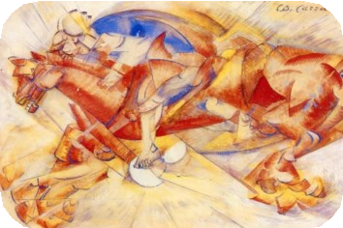
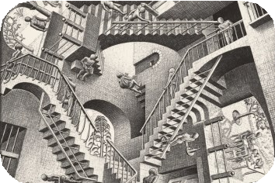
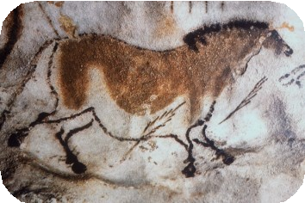
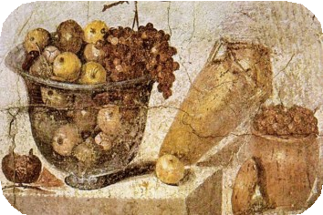

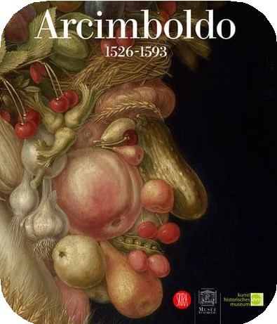
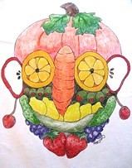
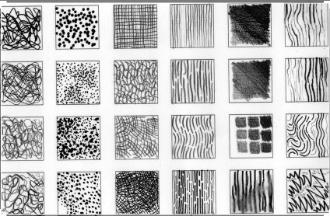
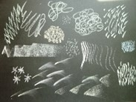
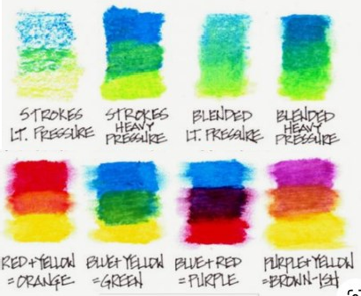
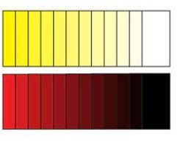
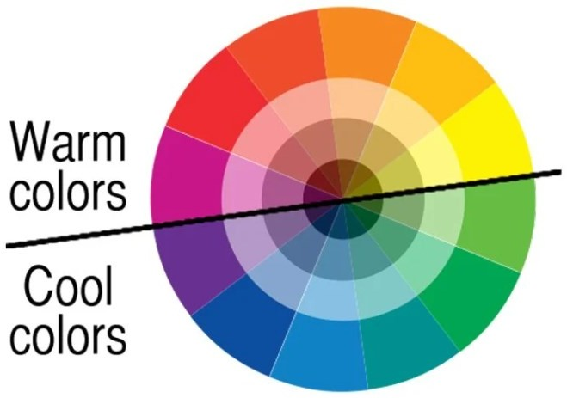
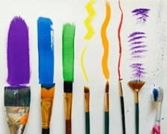
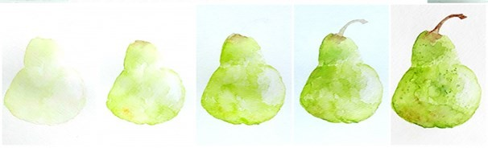
Year 2 – Summer Art - How can we use Giuseppe Arcimboldo’s technique and style to influence our paintings?
Historical and cultural development of art
Cave Paintings
Arcimboldo (1591) Vertumnus
Vermeer (1665) Girl with a Pearl Earring
Vincent van Gogh (1883) Bulb Fields
Carlo Carra (1913) The Red Horseman
M.C. Escher (1953) Relativity Lattice
(30,000 BC)
Citrus Fruit (63-79 BC)
Glossary:
Warm colours-These are colours that remind of the sun or sunset. Warm
colours ae red, yellow and orange.
Cold colours-These are linked to
quietness and sadness. Cold colours are purple, blue and green.
Mood-Mood is the atmosphere that is crated from the painting.
Tint- This is created when white is added to show where light would hit the object.
Tone-This is created when black or
grey is added to show where a shadow would be formed.
Colour wash-The paint is applied to an area in a smooth way, where the
brush strokes cannot be seen.
Charcoal Marks | Chalk Marks
Pastel Marks | Tint and tone
Colour Wheel | Variety of mark making
Giuseppe Arcimboldo (1527-1593)
Pupils will have painted their face in
the style of Giuseppe Arcimboldo.
Sticky Knowledge:
Demonstrate control over the types of marks made with a range of media such as crayons, pastels, felt tips, charcoal, pen, chalk.
Know how to use primary and secondary colours to mix colours for mood.
Know how to use a colour wheel.
Know how to tint and tone colour.
Know how to use the right brush for the right mark.

