Slide 1

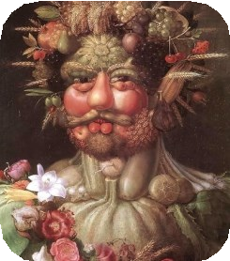
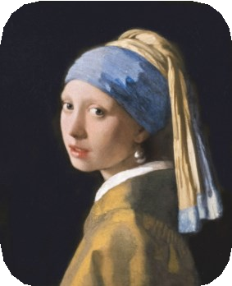
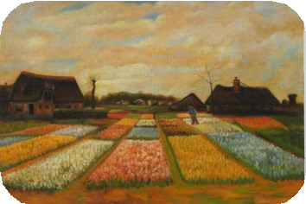
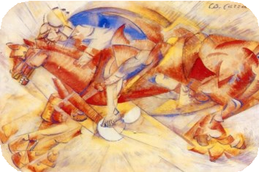
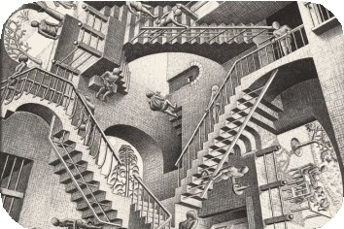
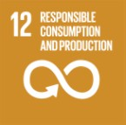
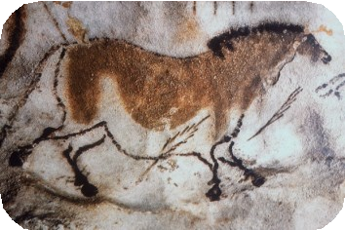
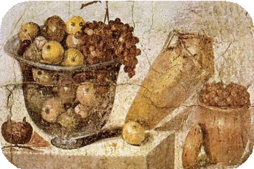
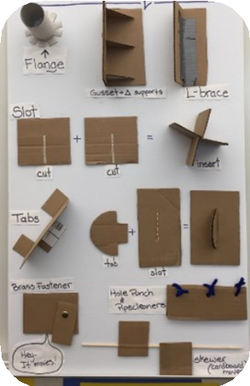
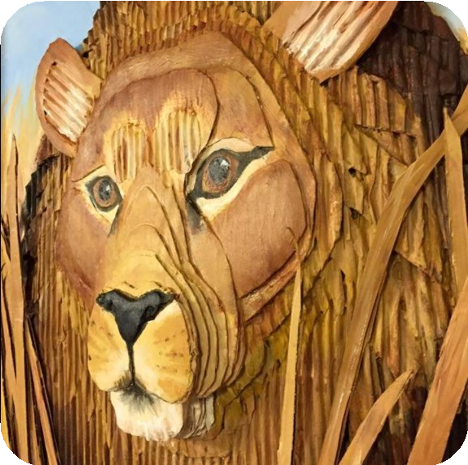
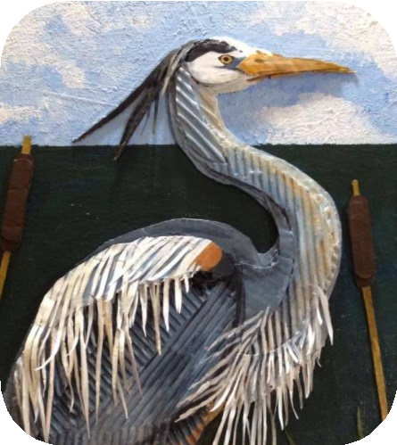
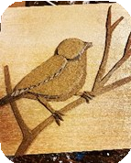
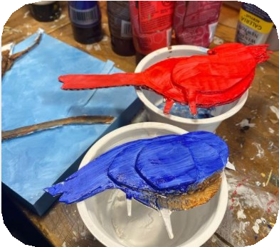
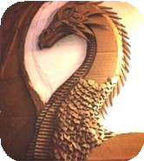
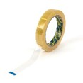
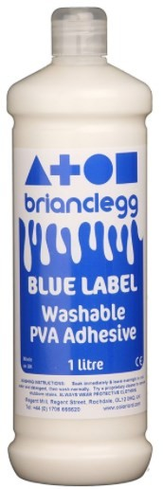
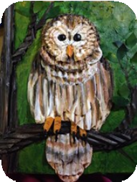
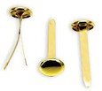
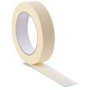

Year 1 - Summer Art - How do artists create a sculpture?
Historical and cultural development of art
Cave Paintings
Arcimboldo (1591) Vertumnus
Vermeer (1665) Girl with a Pearl Earring
SDG LINK
Vincent van Gogh (1883) Bulb Fields
Carlo Carra (1913) The Red Horseman
M.C. Escher (1953) Relativity Lattice
(30,000 BC)
Citrus Fruit (63-79 BC)
Sticky Knowledge:
Know how to make a sculpture.
Know who Tricia Griffiths is and that she is an artist who sculpts.
Know how to join basic materials
using glue, Sellotape, butterfly pins, blue tack etc.
Tricia Griffith—Present Day
Layering materials
Glossary:
Sculpture- A sculpture is a 3 dimensional piece of art. Materials can be carved, moulded, layered, shaped or combined.
Layer- Layering is a gradual build-up of materials being placed on top of each other. The layers can be different sizes so that a shape is made.
3D – A 3D shape has three dimensions, so it is not flat.
Join materials- These are materials that can be used to attach one material to another, such as butterfly pins, sellotape, masking tape, blue tack or glue).
Joining materials

